Slide 1
Finding the Subnet, Broadcast and Useable Host Ranges
Lecture 9
Broadcasting, Distance Vector Routing

Slide 2
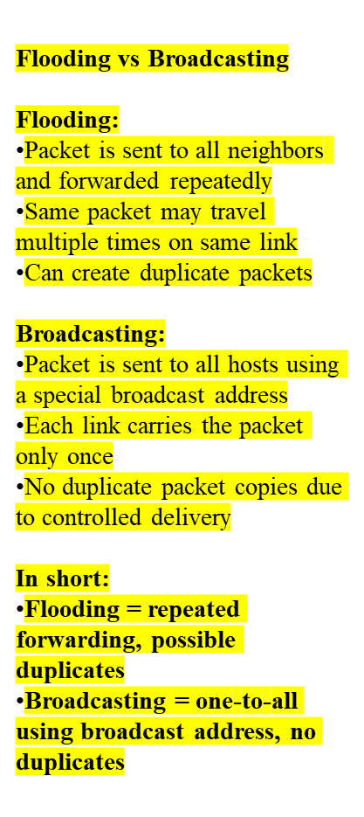
Difference between flooding and broadcasting
Sending a packet to all hosts simultaneously is broadcasting. But flooding does not send packets to all hosts simultaneously. The packets would ultimately reach all nodes in the network due to flooding. Flooding may send the same packet along the same link multiple times, but broadcasting sends a packet along a link at most once. Several copies of the same packet may reach nodes in flooding, while broadcasting does not cause that problem. Unlike flooding, broadcasting is done by specifying a special broadcast address on packets.

Slide 3
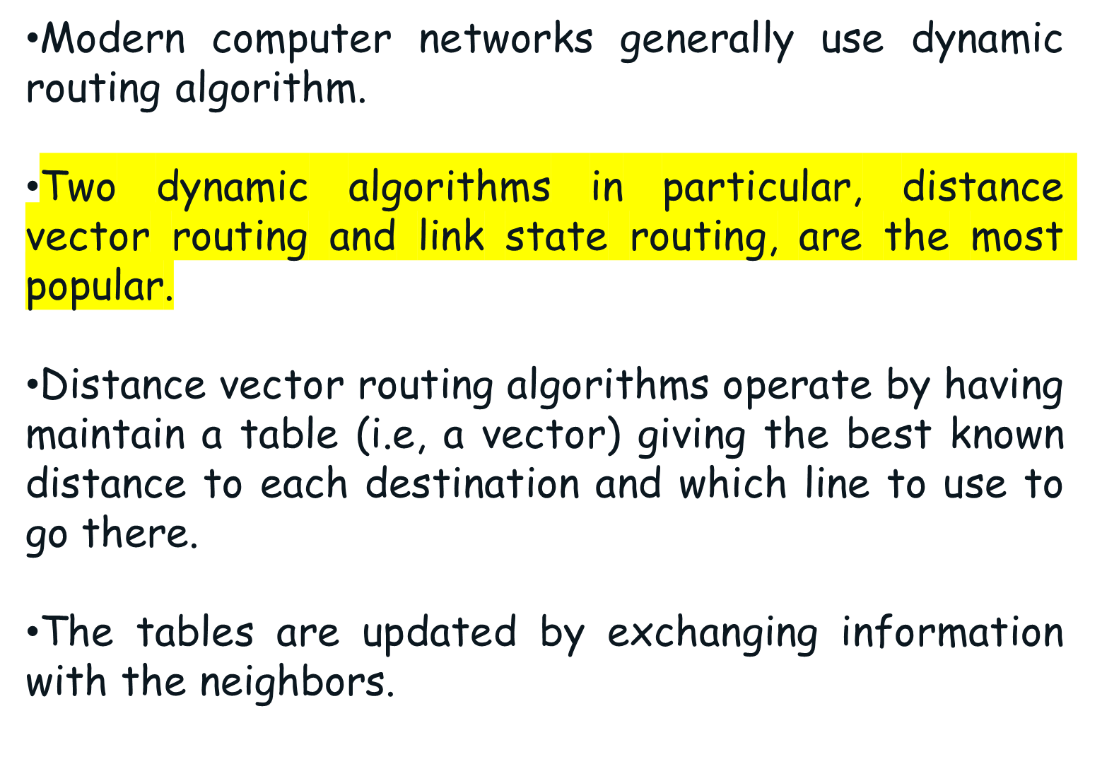
Distance Vector Routing Protocol

Slide 4
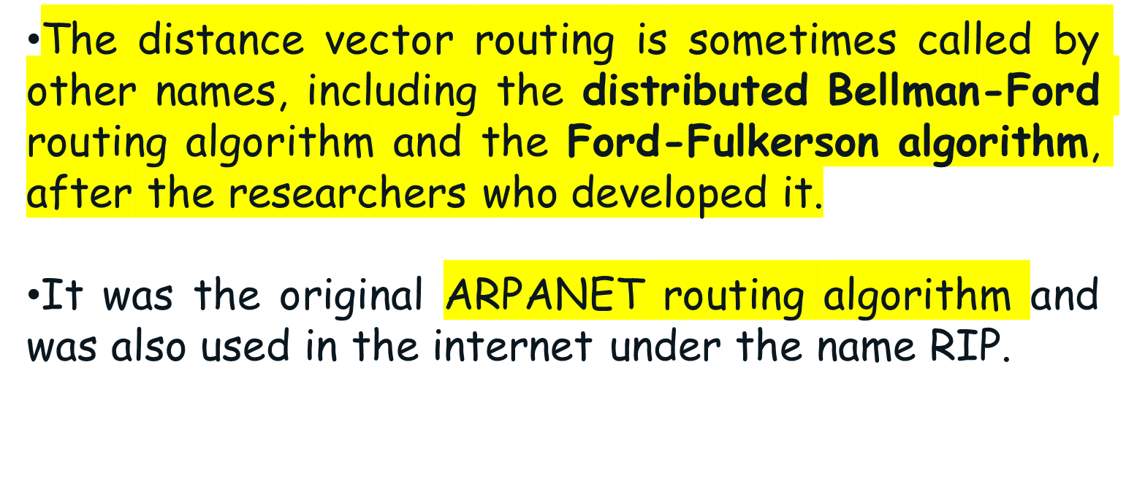
Cont.

Slide 5
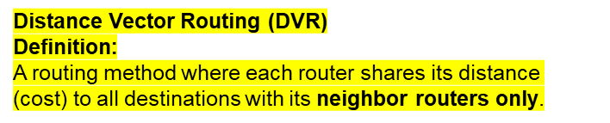
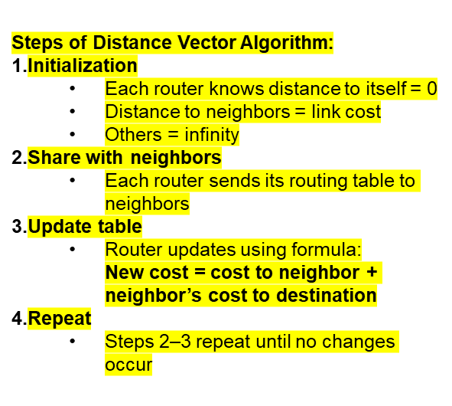
The Meaning of Distance Vector
A router using distance vector routing protocols knows TWO things:
Distance to final destination(Distance is commonly defined as the number of steps, or hosts, a message must go through to get to its destination.)
Vector, or direction, traffic should be directed.(The vector describes the trajectory of the message over a given set of network nodes.)

Slide 6
Cont.
Each node computes its forwarding table in a distributed settings:
Nodes know only the cost to their neighbors; not the topology.
Nodes can talk only to their neighbors using messages.
All nodes run the same algorithm concurrently.
Nodes and links may fail. Messages may be lost.

Slide 7
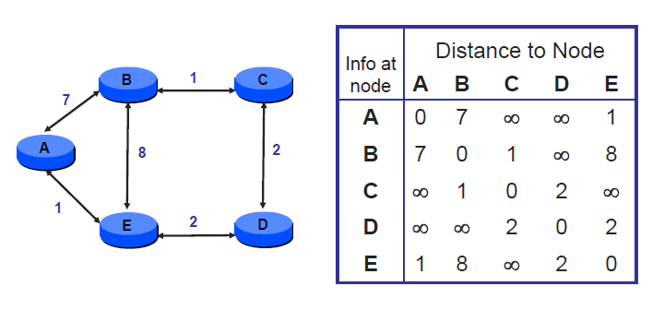
Distance Vector Example: Initial State

Slide 8
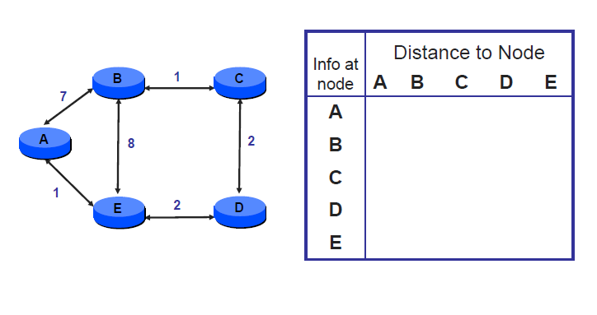
Distance Vector Example: Initial State

Slide 9
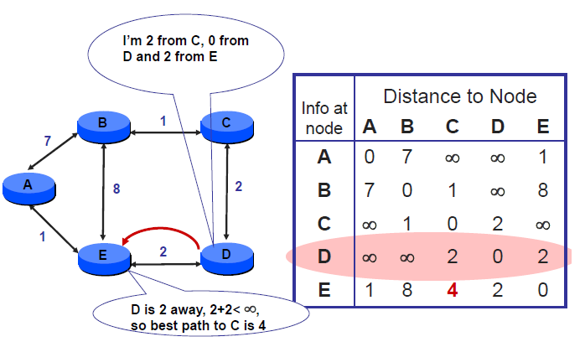
D sends vector to E

Slide 10
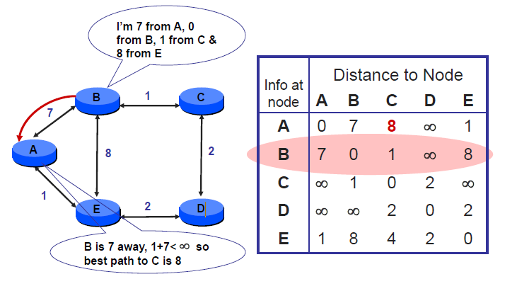
B sends vector to A

Slide 11
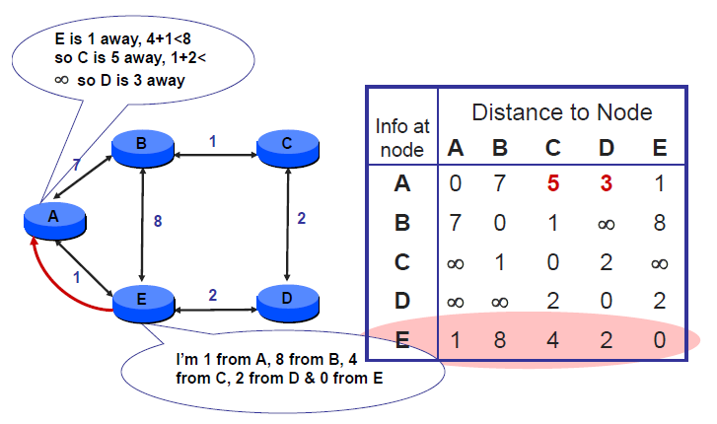
E sends vector to A

Slide 12
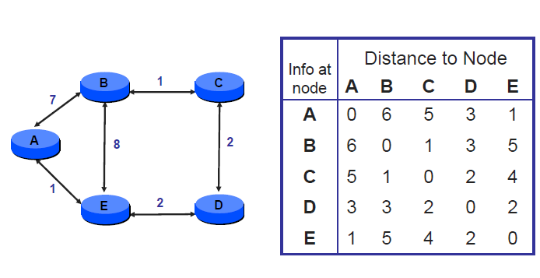
...until Convergence

Slide 13
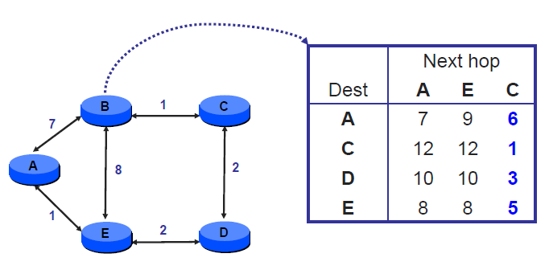
Node B’s distance vectors

Slide 14
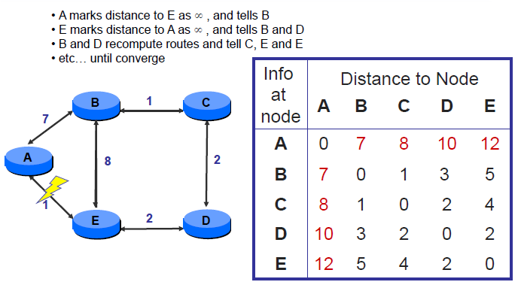
Handling Link Failure

Slide 15
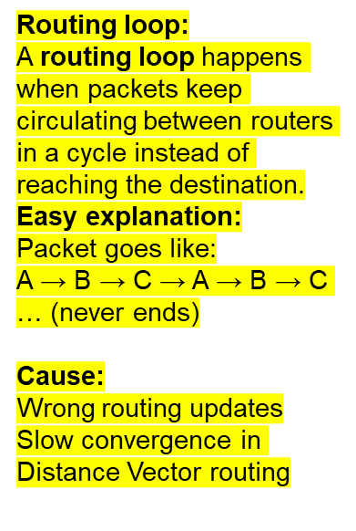
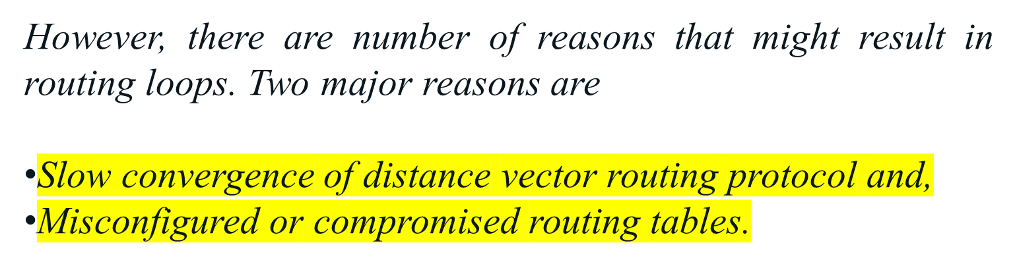
Routing Loop
Routing loop occurs when a data packet is routed through the same route again an again in an endless circle. Routing loops will end up causing serious problems including, increasing CPU processing, increasing link bandwidth and even completely disabling the network.

Slide 16
What is “convergence”?
Routers send updates to each other when change of a network is detected. Network is considered as “converged” once all the routers on a network are updated with the changes. Distance vector routing protocol is well know for its slow convergence, which means that this protocol takes longer to update a change all over the network. So that, in particular time some routers will contain updated information, while some routers contain previous details, leading to problems like routing loops.

Slide 17
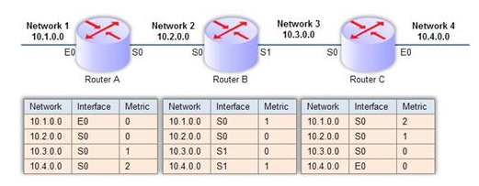
Routing Loop- Example Scenario
Networks column lists all the accessible networks and interface column mentions the interface which is used to access each network. Metric field is used to mention the length of the route or the number of hops between the router and the network. This network is a converged and it’s the default state of the network.

Slide 18
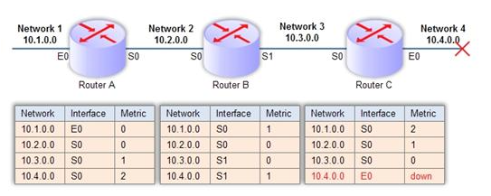
Cont.
Now, we’ll remove the “Network 4″ from the network and see what might cause a routing loop.
“Network 4″ is down. “Router C” updates its routing table as shown. However because of the slow convergence of distance vector routing protocol, “Router B” is still unaware of the unavailability of the network. In that case, Router B’s routing tables still says “Network 4″ is accessible through interface S1 and it is 1 hop away from the “Router B”. As mentioned before, routers send routing tables to neighboring routers.

Slide 19
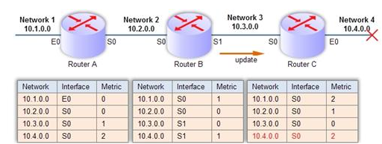
Cont.
Imaging “Router B” sends an update message to “Router C” in this occasion.
“Router C” knows that “Network 4″ is inaccessible at the moment through E0 interface. However, “Router C” gets the update from “Router B” saying that “Network 4″ is 1 hop away from “Router B”. Because of this update message “Router C” gets the idea that “Network 4″ is accessible through “Router B”. So that “Router C” updates its routing table, reflecting this change, mentioning that “Network 4″ is reachable through interface S0, in distance of two hops.

Slide 20
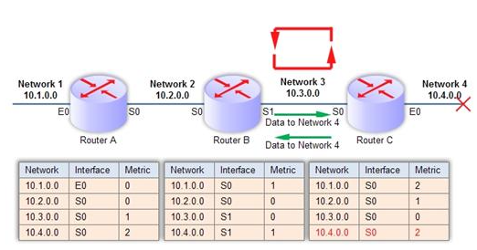
Cont.
Imagine that it is necessary to send some data from “Network 2″ to “Network 4″.

Slide 21
Cont.
“Network 2″ will forward data to “Router B”. “Router B” will refer its routing tables and identify that “Network 4″ is reachable through interface S1 in distance of 1 hop. So that it’ll forward traffic to “Router C”, which is the next hop in the route. “Router C” will refer its routing table and identifies that “Network 4″ is assessable through interface S0 in distance of 2 hops. So that “Router C” will forward traffic to “Router B”. “Router B” gets the traffic back, that is to be delivered to “Network 4″ and it will in turn forward traffic to “Router C”. It is clear that routing loop is created here. “Router B” and “Router C” will keep forwarding traffic between each other, which should be sent to “Network 4″. This will consume the bandwidth of communication line between “Router B” and “Router C” for a useless loop and also the processing power of router will be wasted.

Slide 22
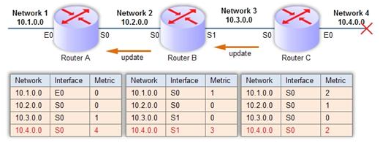
Cont.
Eventually, “Router C” might send an update back to “Router B” and “Router B” might send an update to “Router A”, messing all three touting tables as shown below.
Now, because of slow convergence of distance vector protocol a routing loop has been formed and entire network is containing wrong routing information.

Slide 23
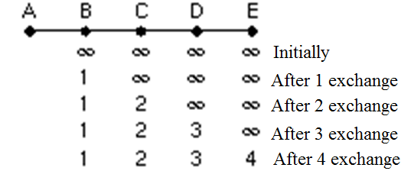
The Count-to-Infinity Problem
DV routing works in theory but has a serious drawback in practice: although it converges to the correct answer, it may do so slowly.
In particular, it reacts rapidly to good news, but leisurely to bad news.
To see how fast good news propagates, consider the five node linear subnet, where the delay metric is number of hops

Slide 24
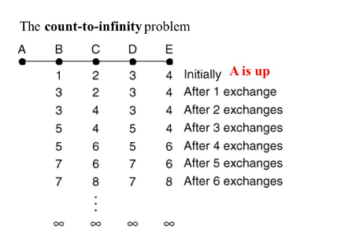
Cont.
Initially all the lines and routers are initially up.
Routers B, C, D and E have distances to A of 1,2,3 and 4 respectively.
Suddenly the line between A and B is cut.

Slide 25
Cont.
At the first packet exchange, B does not hear anything from A. Fortunately C says “Do not worry. I have a path to A of length 2.” Little does B know that C’s path runs through B itself. For all B knows that C might have another outgoing line with independent path to A of length 2. As a result, B now thinks it can reach A via C, with path length of 3. D and E do not update their entries for A on the first exchange.

Slide 26
Cont.
On the second exchange, C notices that each of its neighbors claims to have a path to A of length 3. It picks one of them at random and makes its new distance to A 4, as shown in third row.

Slide 27
Cont.
On the third exchange, D notices that each of its neighbors claims to have a path to A of length 4. It picks one of them at random and makes its new distance to A 5, as shown in third row.
Also B notices that it can reach A via C and it makes its new distance to A 5.

Slide 28
Cont.
On the fourth exchange, E can reach A via D and make its distance to A as 6. Also C notices that each of its neighbors claims to have a path to A of length 5. It picks one of them at random and makes its new distance to A 6, as shown in fourth row. Subsequently exchanges produce the history shown in the rest of the figure. Gradually, all the routers work their up to infinity.

Slide 29
RIP (Routing Information Protocol)
DV protocol with hop count as metric
Infinity is 16 hops
Includes split horizon
Router send vectors every 30 sec.
Runs on top of UDP
RIPv1 specified in RFC1058(1988)
RIPv1 exploits broadcasting.

Slide 30
RIP (Routing Information Protocol)-Cont.
RIP1 supports class full routing protocol (FLSM)
RIP version 2 is an extension of RIP version one. Subnet masks are carried in the route information.
Authentication was included in RIP version 2 although the authentication is not very full proof.
RIP2 supports class less routing protocol. (VLSM)
Route information carries next hop address and exploits IP multicasting.

Slide 31
Split Horizon
If you are using RIPv1, you have a solution in the form of a concept called split horizon.
The Split horizon algorithm works the same way as distance vector routing.
However in this concept, if you receive routing on one interface, sending that information back out of that interface is not likely to be productive.
That is do not report route to destination from which the route was learned.

Slide 32
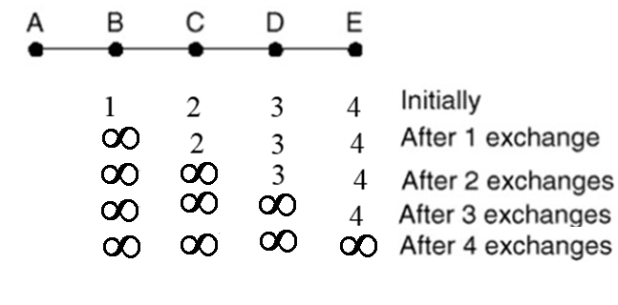
Cont.
In the initial state, for example, C tells D the truth about the distance to A, but C tells B that its distance to A is infinite.
Similarly, D tells the truth to E but lies to C.

Slide 33
Cont.
Now let see what happens when A go down.
On the first exchange B discovers that the direct line is gone and C is reporting an infinite distance to A as well.
Since neither of its neighbors can get to A, B sets its distance to infinity.

Slide 34
Cont.
On the next exchange, C hears that A is unreachable from both of its neighbors, so it marks A as unreachable too.
Using split horizon, the bad news propagates one hop per exchange.

Slide 35
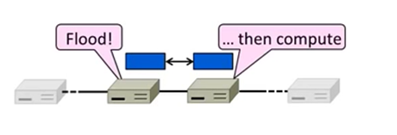
Link State Routing
How to compute shortest paths in a distributed network
    The Link-State (LS) approach
  One of two approaches to dynamic routing
    Trades more computation than distance vector for better dynamics
Widely used in practice
  Used in internet/ARPANET from 1979
  Modern networks use OSPF(Open Shortest Path First) and IS-IS (Intermediate system to Intermediate system)

Slide 36
Cont.
Each node computes its forwarding table in the same distributed settings as for distance vector:
Nodes know only the cost to their neighbors; not the topology.
Nodes can talk only to their neighbors using messages.
All nodes run the same algorithm concurrently.
Nodes and links may fail. Messages may be lost.

Slide 37
Link-State Algorithm
Proceeds in two phases:
Nodes flood topology in the form of link state packets
  Each node learns full topology
Each node computes its own forwarding table
  By running Dijkstra (or equivalent)

Slide 38
Link-State Algorithm
Distance vector routing differs significantly from the link state routing.
With link state algorithms, routers share only the identity of their neighbors, but they flood this information through the entire network.
Distance vector algorithms adopt an opposite approach.
Routers periodically share knowledge of the entire network, but only with their neighbors.

Slide 39
How Link State Routing Works-Example 1
Link state - router knows entire network topology and computes shortest pathRouting.
Each node send it’s neighbor information known as Link State Advertisement.
LS advertisement sent of periodic basis.
Once node has complete view of network then it populate it’s routing table by using Dijkastra alogorithm for shortest path.

Slide 40
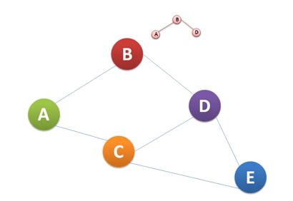
Cont.
Node B’s LS advertisement

Slide 41
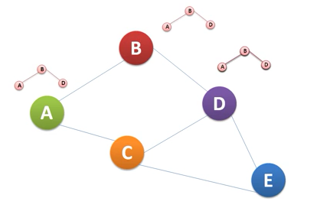
Cont.

Slide 42
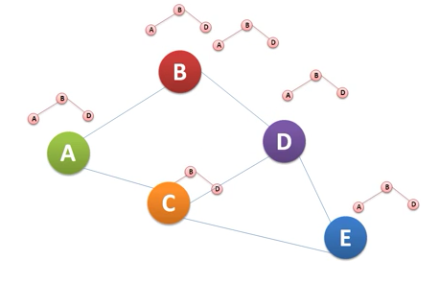
Cont.
Node B would find out that this message has been sent by B.

Slide 43
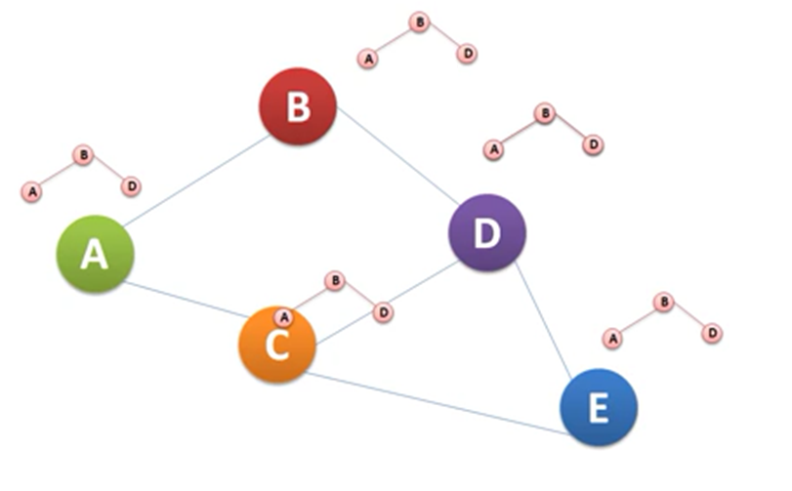
Cont.

Slide 44
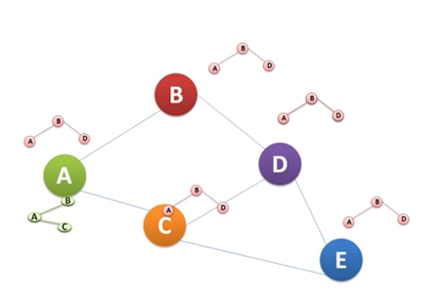
Cont.
Node A’s LS advertisement

Slide 45
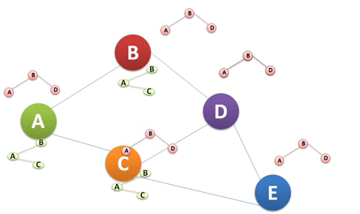
Cont.

Slide 46
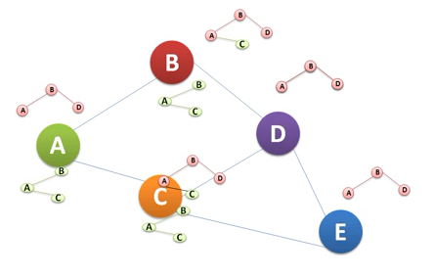
Cont.
On Receiving A’s LS node B and C will update their topology information and also forward these packets.

Slide 47
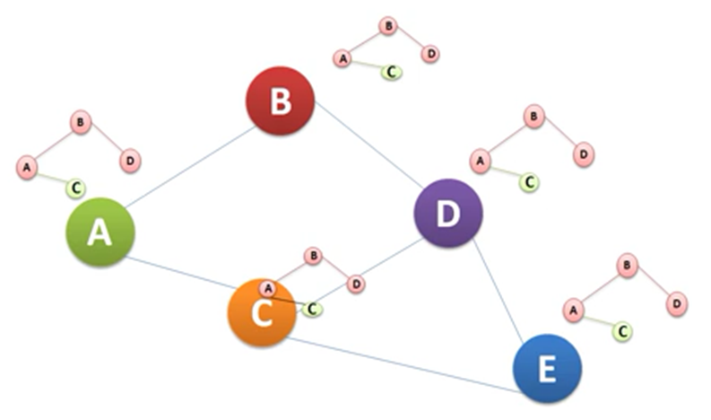
Cont.

Slide 48
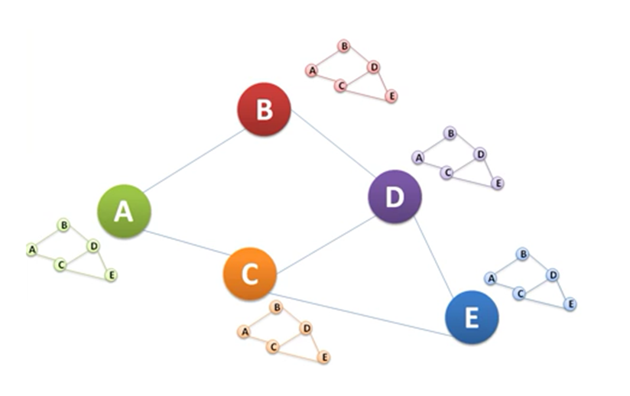
Cont.
After exchange of LS advertisement from, every node will be having complete view of network.
LS advertisement sent of periodic basis.
Once node has complete view of network then it populate it’s routing table by using Dijkastra alogorithm for shortest path.

Slide 49
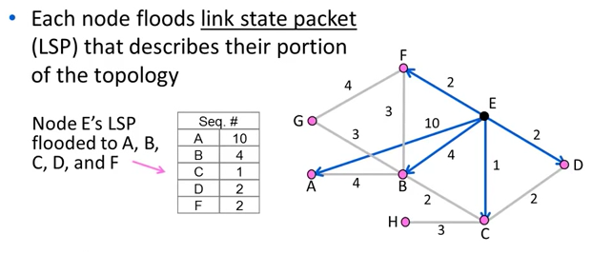
Example 2
Phase 1: Topology Dissemination

Slide 50
Cont.
Phase 2: Route Computation
Each node has full topology
    By combining all LSPs
Each node simply runs Dijkstra
  Some replicated computation, but finds required routes directly
  Compile forwarding table from source tree.

Slide 51
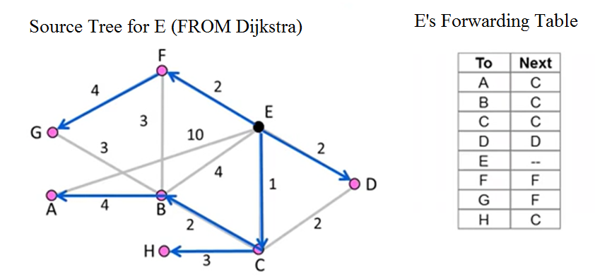
Forwarding Table

Slide 52
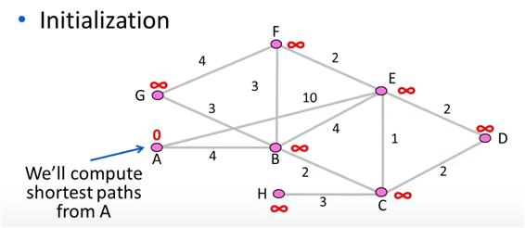
Review
How to compute shortest paths given the network topology
  -With Dijkstra’s algorithm

Slide 53
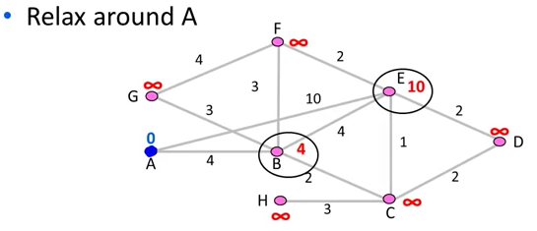
Cont.
Both E and B nodes have been relaxed.

Slide 54
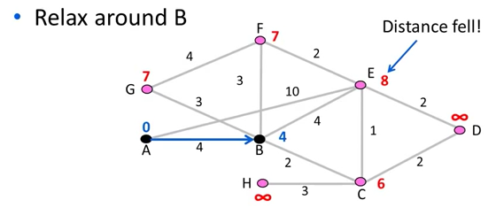
Cont.

Slide 55
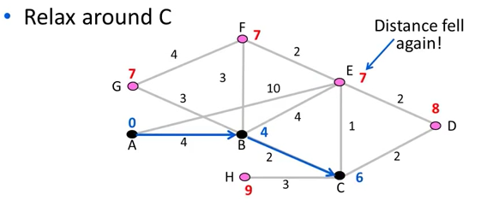
Cont.

Slide 56
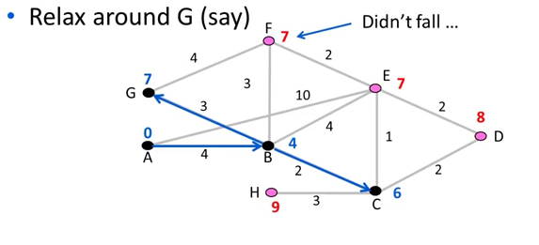
Cont.

Slide 57
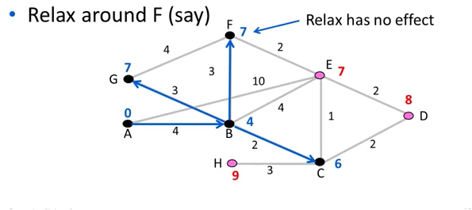
Cont.

Slide 58
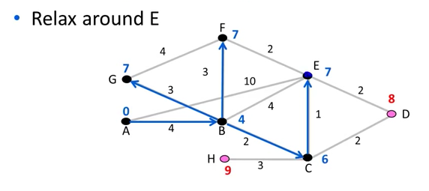
Cont.

Slide 59
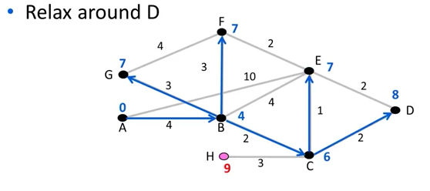
Cont.

Slide 60
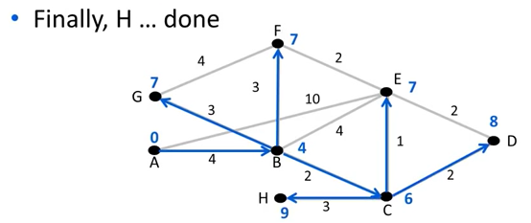
Cont.

Slide 61
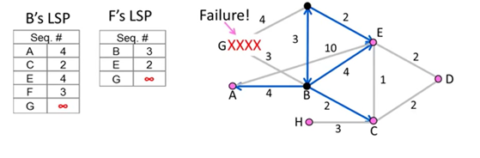
Handling Changes
On change, flood updates LSPs, and re-computes routes
  -e.g., nodes adjacent to failed link or node initiate.

Slide 62
Handling Changes
Link Failure
- Both nodes notice, send updates LSPs
- Link is removed from topology
Node failure
  -All neighbors notice a link has failed
    Failed node can’t update its own LSP
    But it is OK: all links to node removed.
    Addition of a link or node
      - Add LSP of new node to topology
      - Old LSPs are updated with new link

Slide 63
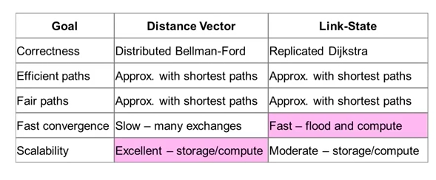
DV/LS Comparison

Slide 64
Hierarchical Routing
As networks grow in size, the router routing tables grow proportionally. Not only is router memory consumed by ever-increasing tables, but more CPU time is needed to scan them and more bandwidth is needed to send status reports about them. At a certain point, the network may grow to the point where it is no longer feasible for every router to have an entry for every other router, so the routing will have to be done hierarchically, as it is in the telephone network.

Slide 65
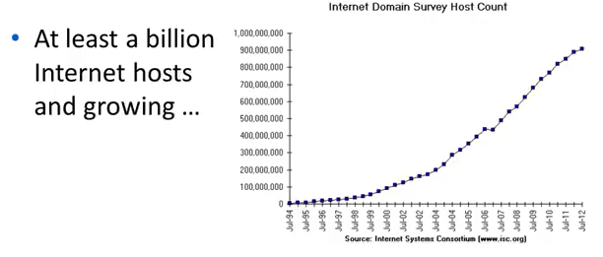
Internet Growth

Slide 66
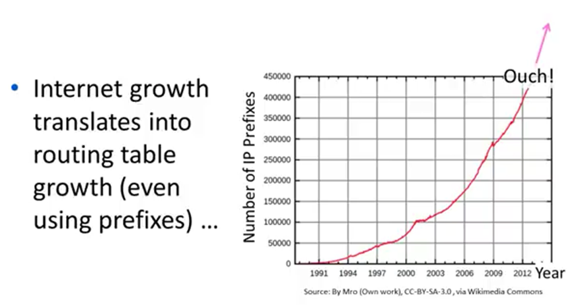
Internet Routing Growth

Slide 67
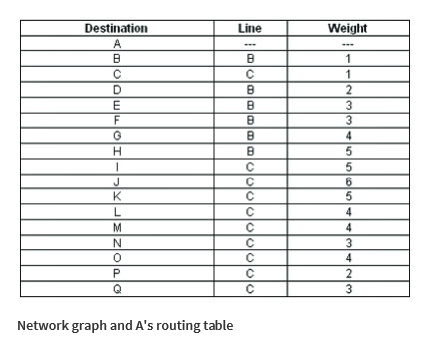
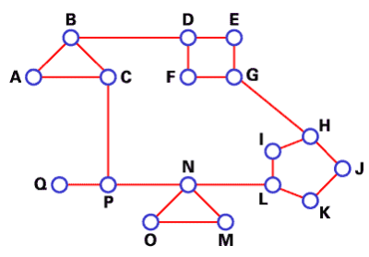
Example
Figure below gives a quantitative example of routing in a two-level hierarchy with five regions. We use DV algorithm to find best routes between nodes. The full routing table for router A has 17 entries, as shown in The.

Slide 68

Cont.
When routing is done hierarchically, as in Fig. (c), there are entries for all the local routers, as before, but all other regions are condensed into a single router, so all traffic for region 2 goes via the B-D line, but the rest of the remote traffic goes via the C-P line. Hierarchical routing has reduced the table from 17 to 7 entries. As the ratio of the number of regions to the number of routers per region grows, the savings in table space increase.
Destination | Line | Hop
A | - | -
B | B | 1
C | C | 1
Region 2 | B | 2
Region 3 | C | 4
Region 4 | C | 3
Region 5 | C | 2

Slide 69
Cont.
Unfortunately, these gains in space are not free. There is a penalty to be paid: increased path length. For example, the best route from A to H is via region 2, but with hierarchical routing all traffic to region 3 goes via region 5, because that is better for most destinations in region 3.
Destination | Line | Hop
A | - | -
B | B | 1
C | C | 1
Region 2 | B | 2
Region 3 | C | 4
Region 4 | C | 3
Region 5 | C | 2

Slide 70
Cont.
When a single network becomes very large, an interesting question is ‘‘how many levels should the hierarchy have?’’
For example, consider a network with 720 routers. If there is no hierarchy, each router needs 720 routing table entries.
If the network is partitioned into 24 regions of 30 routers each, each router needs 30 local entries plus 23 remote entries for a total of 53 entries.
If a three-level hierarchy is chosen, with 8 clusters each containing 9 regions of 10 routers, each router needs 10 entries for local routers, 8 entries for routing to other regions within its own cluster, and 7 entries for distant clusters, for a total of 25 entries.

